Slide 1
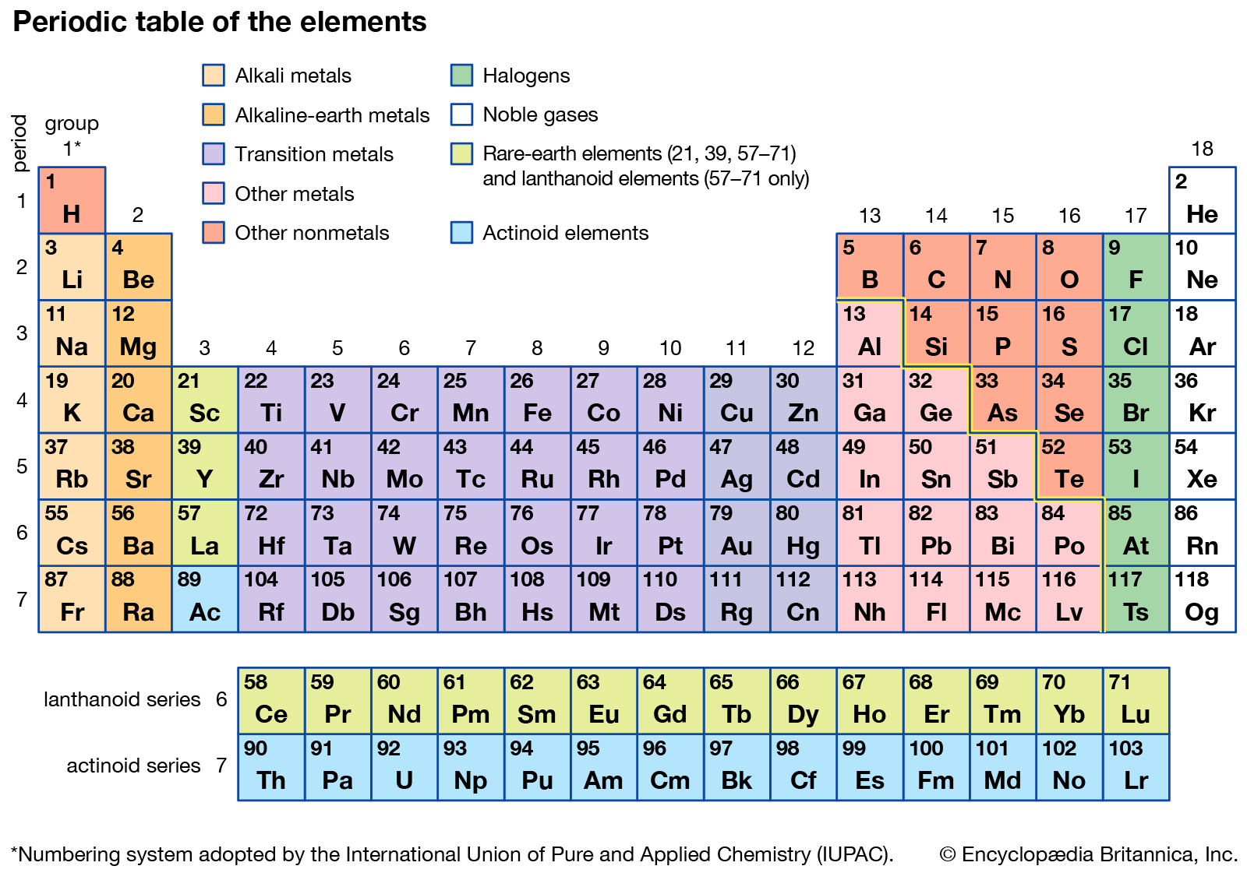
PERIODIC TABLE
We will interpret the periodic table
Notes:
Insert cover image and use transparency settings to fade image.

Slide 2
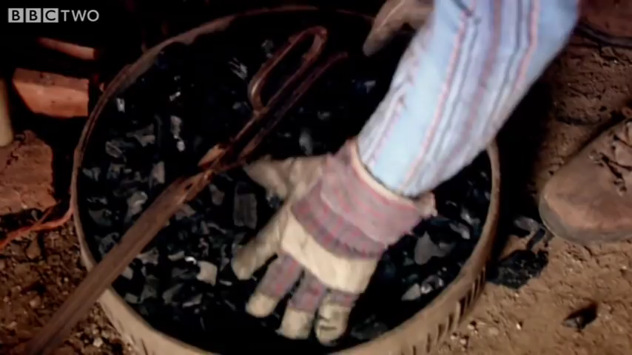

Slide 3
Do not delete this slide.
This slide is designed so that you can copy the prompt box you need and insert it into your slides.
This slide is hidden and will not be included when presenting your lesson.
TRACK WITH ME
VOCABULARY
1 -
HINT
Students, remember….
CHECK FOR UNDERSTANDING
READ WITH ME
TEACHER CUE
MAKE THE CONNECTION
Students, you already know….
EXTENSION
GESTURE WITH ME

Slide 4
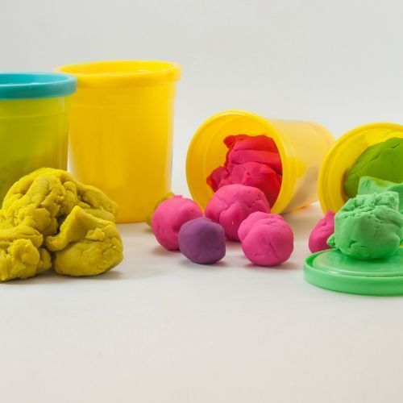
We will demonstrate lighting and extinguishing a Bunsen burner safely.
Describe these sparklers using physical and chemical properties.

Slide 5
We will interpret the periodic table
TRACK WITH ME
READ WITH ME
We will define elements, compounds and mixtures
We will define and label diagrams of atom
We will use the periodic table to identify numbers of protons, neutrons and electrons
DECLARE THE OBJECTIVE
Read the learning objective to your partner.
Notes:
Learning Objectives contain concepts (nouns, big ideas), skills (verbs, measurable behaviours) and sometimes context (restricting or targeting conditions).
●Example: Students will be able to describe the concept of density and apply it to floating and sinking.
●
Success criteria are specific measurable outcomes that if met mean that the student has met the learning objective.
Examples:
•Students will be able to compare densities of substances using mass and volume.
•Students will be able to identify whether a solid or liquid will float or sink in a liquid based on their densities.

Slide 6
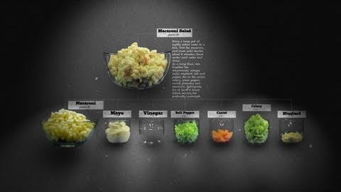
We will interpret the periodic table
Sort these into elements, compounds and mixtures:
Water
Sodium
Salad
Carbon Dioxide
Cereal
Gold
Sodium Chloride
Elements | Compounds | Mixtures

Slide 7
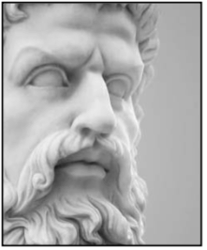
We will interpret the periodic table
The Ancient Greeks
One of the most influential thinkers of the time was Aristotle (384-322 BCE). He was one of the first people (that we know of) to try to answer the question “what is everything made of?”
He decided that everything was made of just 4 basic constituents, or “elements”; earth, water, air and fire.
What do you think the word “element” might mean?
Aristotle (384-322 BCE)

Slide 8

We will interpret the periodic table
Modern Science
One of the important processes that has been developed in modern science is decomposition. This means to break a substance down into simpler, more basic parts.
Some substances could never be decomposed any further, no matter what was done to them. These became known as “chemical elements”... the most basic substances of all matter.

Slide 9
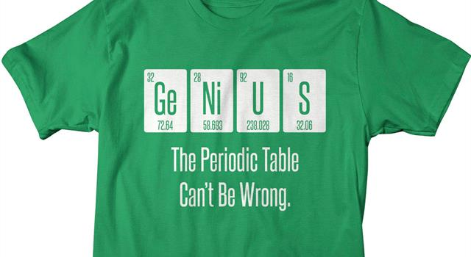
We will interpret the periodic table
How Many Elements?
We now know that about 90 chemical elements occur naturally on Earth.
Another 20 (or so) can be made artificially in nuclear reactors.
Of these elements, many are very rare.
All the familiar substances on Earth are composed of only about 20-30 of the most common elements.

Slide 10
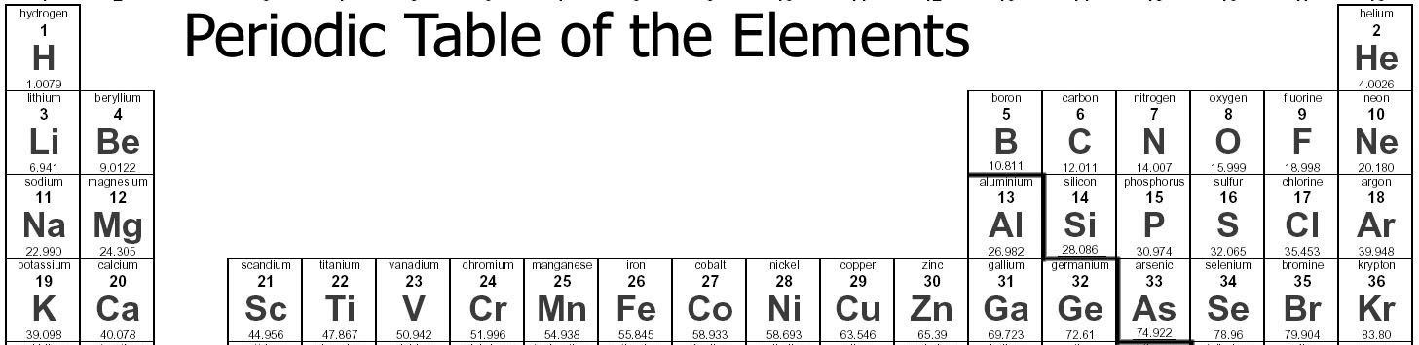
We will interpret the periodic table
In Year 8 Chemistry you must know the symbol and name of the first twenty elements.

Slide 11
We will interpret the periodic table
What is the periodic table?
Shows all the known elements in the universe.
Organises the elements by chemical properties.
Elements: pure substance which cannot be broken down by chemical means

Slide 12
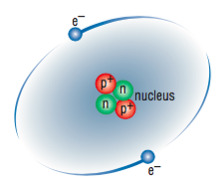
We will interpret the periodic table
What is an atom?
Atoms are invisible particles that make up all matter.
It was once thought that atoms were indivisible, but scientists now know that….
Atoms are made up from even smaller particles called protons (often shown as p), neutrons (n) and electrons (e).

Slide 13
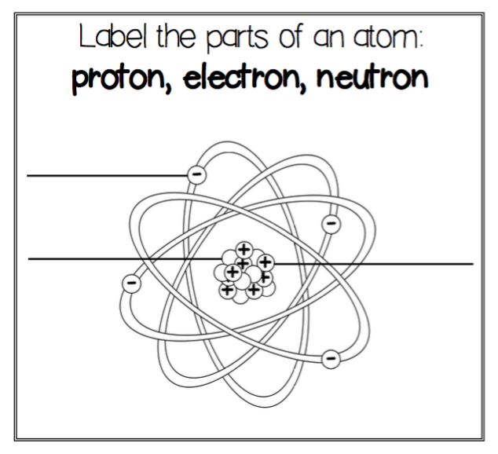
We will interpret the periodic table
What is an atom?
Draw down this atom -->

Slide 14
We will interpret the periodic table
What is an atom made up of?
Protons: positively charged particles located in the nucleus
Neutrons: neutral particles located in the nucleus
Electron: negatively charged particles located in the electron cloud (outside the nucleus)
Nucleus: positively charged central core of an atom, consisting of protons and neutrons and containing nearly all its mass.

Slide 15
We will interpret the periodic table
Where is the nucleus?
Where is
the electron
cloud?

Slide 16
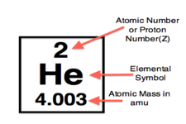
We will interpret the periodic table
Element Tile:
Element Symbol:
Atomic number: Number of protons
Mass number:
Number of
protons + neutrons
(total mass of a single atom)

Slide 17
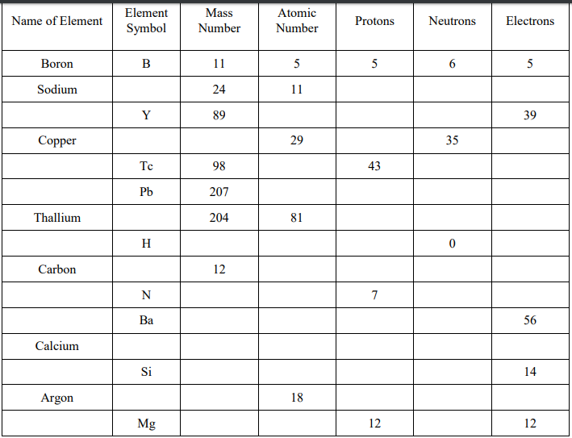
We will interpret the periodic table

Slide 18
We will interpret the periodic table
How do we calculate the number of protons neutrons and electrons in each atom?
Rules:
Number of Protons = Number of Electrons = Atomic Number
Number of Neutrons = Mass number – Atomic Number

Slide 19
We will interpret the periodic table
Elemental BINGO:
Draw a four by four grid
Fill the boxes with different element names (first 20)

Slide 20
We will interpret the periodic table
Elemental BINGO:
Draw a four by four grid
Fill the boxes with different element symbol (first 20)

Slide 21
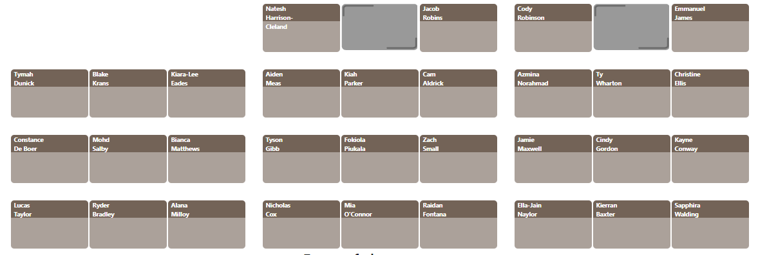
We will interpret the periodic table

Slide 22
We will demonstrate lighting and extinguishing a Bunsen burner safely.
Write the symbols for the following elements; Mercury, Hydrogen and Lithium.
Draw an atom, labelling protons, neutrons and electrons.
How many protons, neutrons and electrons does Sodium and Magnesium have?

Slide 23
We will interpret the periodic table
TRACK WITH ME
READ WITH ME
We will identify metals and non metals within the periodic table
We will understand the properties of metals and non metals
We will name the groups and identify properties within the groups
DECLARE THE OBJECTIVE
Read the learning objective to your partner.
Notes:
Learning Objectives contain concepts (nouns, big ideas), skills (verbs, measurable behaviours) and sometimes context (restricting or targeting conditions).
●Example: Students will be able to describe the concept of density and apply it to floating and sinking.
●
Success criteria are specific measurable outcomes that if met mean that the student has met the learning objective.
Examples:
•Students will be able to compare densities of substances using mass and volume.
•Students will be able to identify whether a solid or liquid will float or sink in a liquid based on their densities.

Slide 24
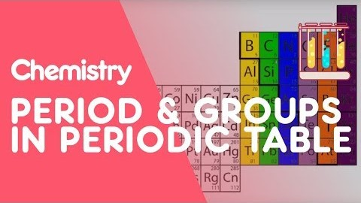
We will interpret the periodic table
1, Number and label your periodic table with groups and periods.
2. What is the difference between groups and periods?

Slide 25
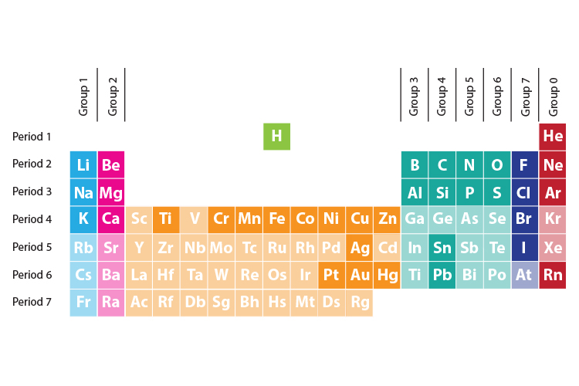
We will interpret the periodic table
Groups: Columns of elements that have similar properties.

Slide 26
We will interpret the periodic table
Periods: Rows of elements that have different properties.

Slide 27
We will interpret the periodic table
Properties of metals and non metals List the properties that you can remember:
Metals: | Non metals:
Shiny Conduct heat and electricity High melting and boiling point Ductile | Dull Non conductors or heat and electricity Low melting and boiling points

Slide 28
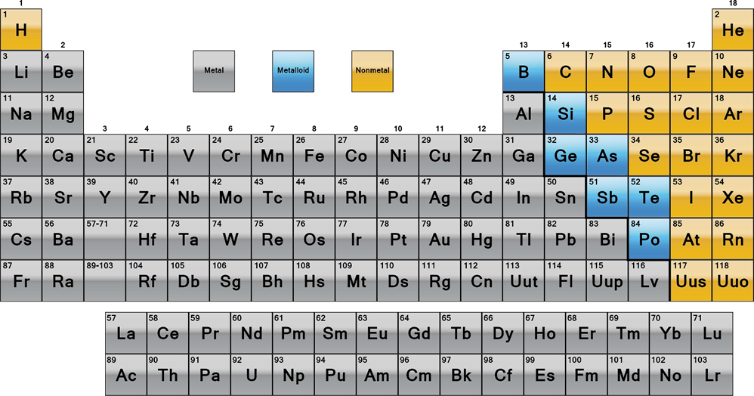
We will interpret the periodic table
Metals and non metals elements

Slide 29
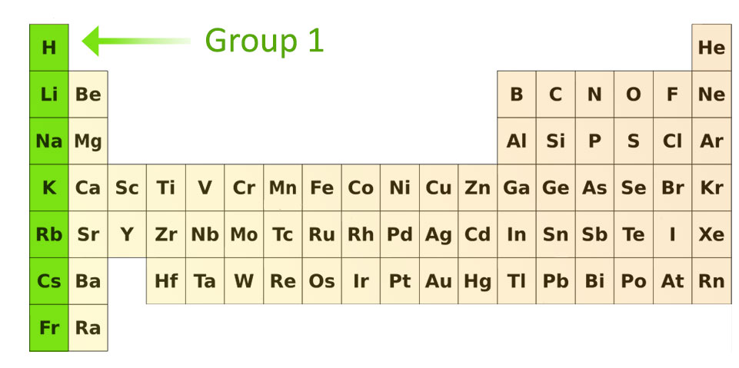
We will interpret the periodic table
Group 1- Alkali metals
Soft
Low melting points
Low Densities
Very reactive (aren’t found naturally)

Slide 30
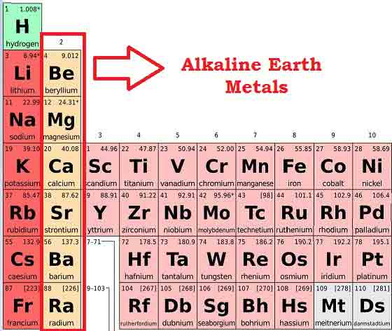
We will interpret the periodic table
Group 2- Alkaline Earth Metals
Reactive
Low melting points
Low Densities
Burn with a brightly coloured flame

Slide 31
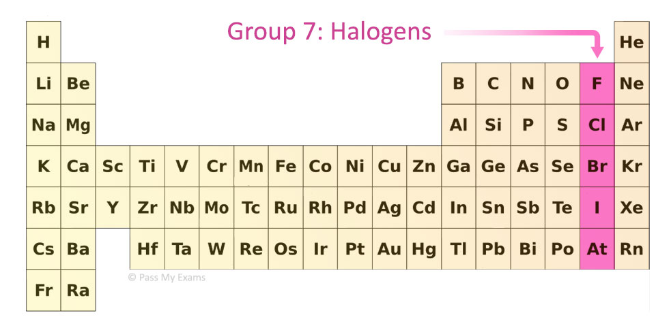
We will interpret the periodic table
Group 7- Halogens
Very Low melting and boiling points
Highly reactive (most reactive non-metals)
Toxic

Slide 32
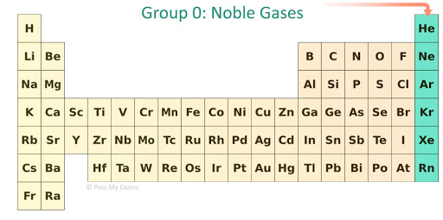
We will interpret the periodic table
Group 8- Noble Gases
Odourless
Colourless
Low Reactivity

Slide 33
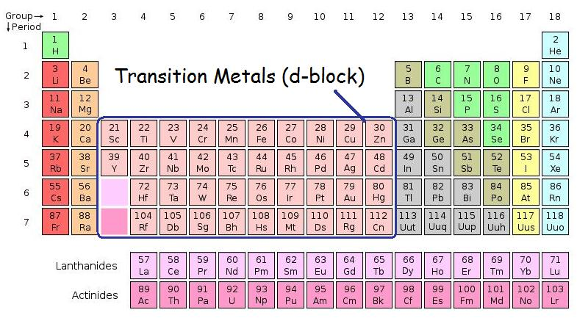
We will interpret the periodic table
Group 3-12 – Transition Metals
Very Hard
High melting and boiling points
Can form coloured solutions and compounds

Slide 34
We will interpret the periodic table
Activity Time:
Label your periodic table with all the new group names you’ve just learnt.
Use colours to divide your periodic table into metals and non metals.

